Slide 1
A new era of text processing
Ali Hürriyetoğlu
SICSS-Istanbul
July 4, 2023

Slide 2
Outline
How was it?
Natural language processing (NLP)
Machine learning (ML)
What are the recent breakthroughs?
What is the result?

Slide 3
Traditional: NLP - linguistics
You need to know about morphology, syntax, semantics, pragmatics, writing rules, etc.
The text should be processed in a bottom-up fashion.
tokens, POS tags, dependency parsing, …
Language resources had a key role
lexicons, dictionaries, gazetteers, lemmas, stop words, entity lists, …
The developer should control all steps
rules, configurations, …
The output of these steps is mainly an input to higher level goals

Slide 4
Traditional: NLP - tasks
You can get the result for a task you can formulate using the output of the basic steps defined in the previous slides.
Named entity recognition: Extract if two tokens occur subsequently and the first one is in a first names list and the second one occur in a surnames list
Text classification: If a token or set of tokens occur in a text, make a decision
More tasks
Sentiment analysis
Automatic summarization
Event extraction
Machine translation
Information extraction
Topic detection

Slide 5
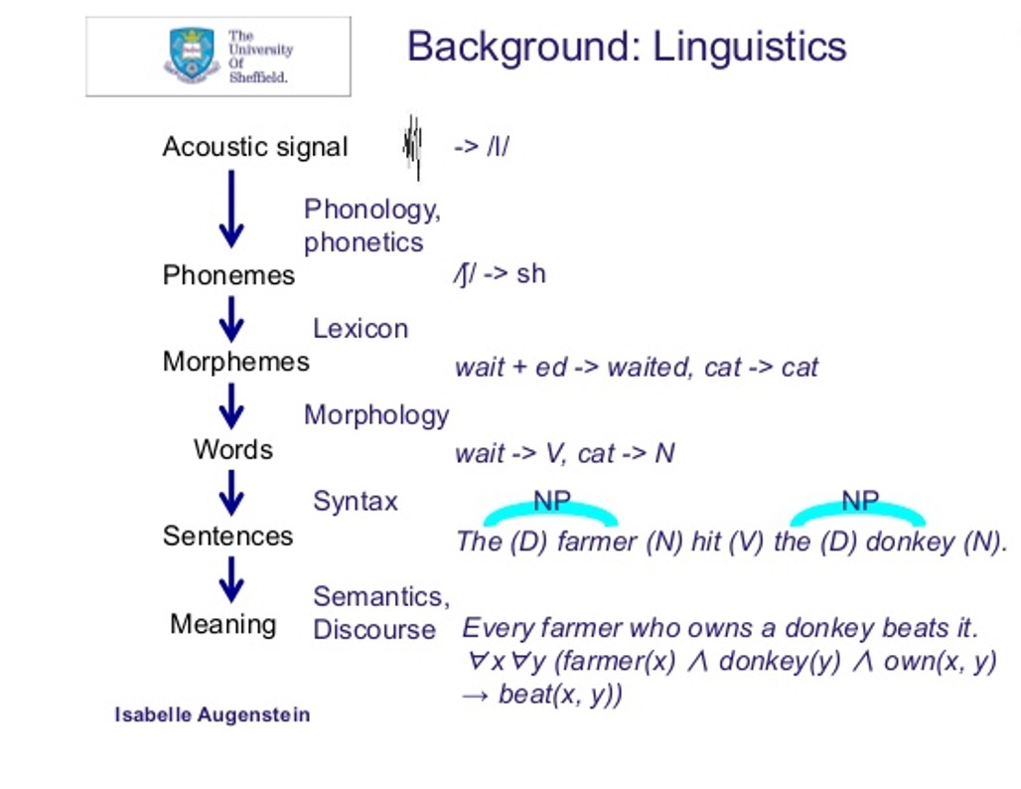
Traditional: NLP - pipeline, sample 1

Slide 6
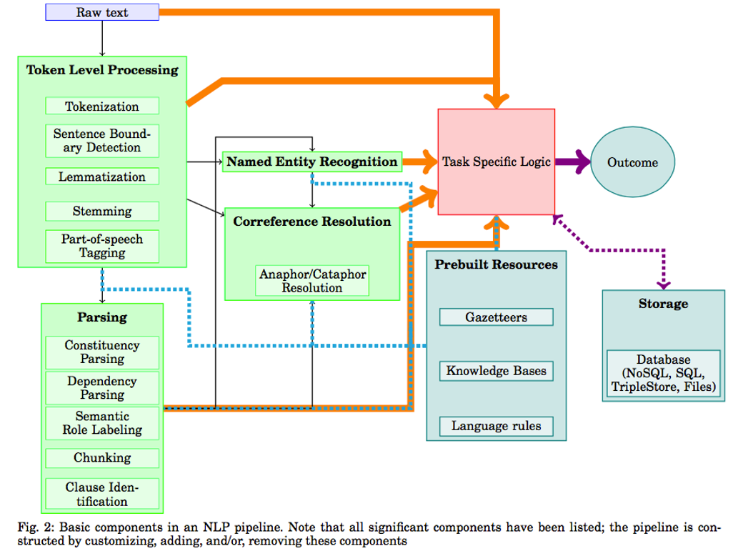
Traditional: NLP - pipeline, sample 1

Slide 7
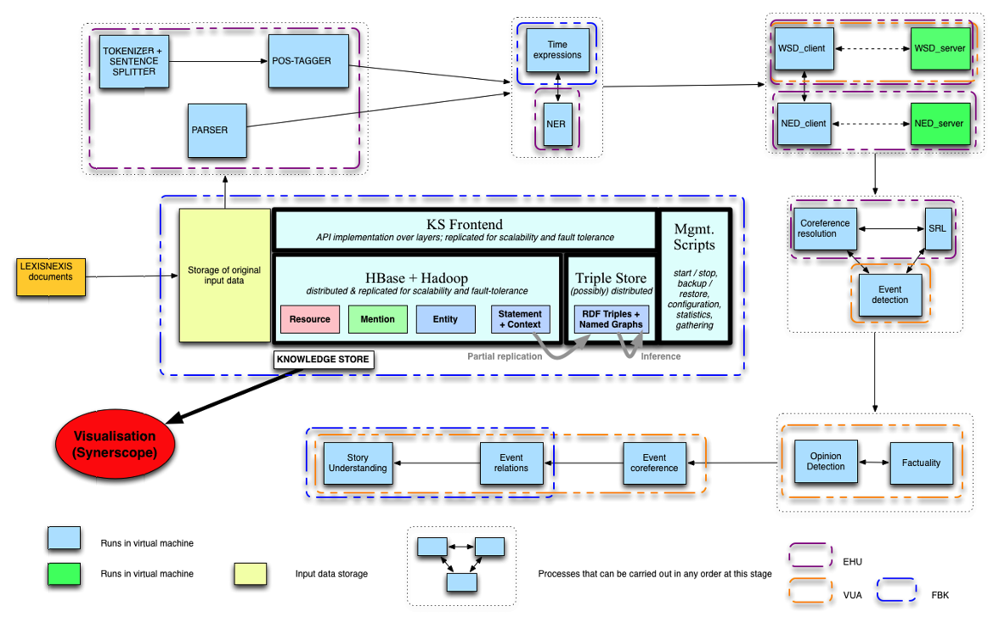
Traditional: NLP - pipeline, sample 1

Slide 8
Traditional: NLP - Pros
Widely used: text processing industry has been using it for decades and does not plan to leave it.
Cheap
Controllable
Explainable: You can explain why a decision is made
Debuggable: You can fix it and improve it

Slide 9
Traditional: NLP - Cons
The text should have a structure or certain level of specificity to achieve good results
News articles are written following standard/official writing rules
Easy to start, but you cannot predict how much effort you should spend to significantly improve performance of the system.
The longer a text is the harder it is to make an automatic decision about significance of an occurrence of a token in a text classification task
Significant performance drop for new documents, new languages, new styles
Specific tasks are mostly effective at sentence level
It is much harder to identify and incorporate inter-sentence information.

Slide 10
Traditional: ML
You can attempt to solve almost any text mining task with machine learning approaches. The quality of the outcome will depend on:
Feature extraction and selection
Amount of labeled data in supervised learning
Time you have to analyze the output in unsupervised learning
It may be optional to use it if you can formulate a solution with the language resources and rules you have
You must use it for an acceptable performance if you are dealing with some problem you cannot formulate and operationalize.
Can you predict whether a document is spam or not using a formulation based on words?

Slide 11
Traditional: ML
Use statistics and optimization techniques to identify an optimal predictor
Feature engineering
tokens, word ngrams, character ngrams, vocabulary/lexicon/gazetteer based lists,
Feature selection methods
Statistical tests for importance of the features

Slide 12
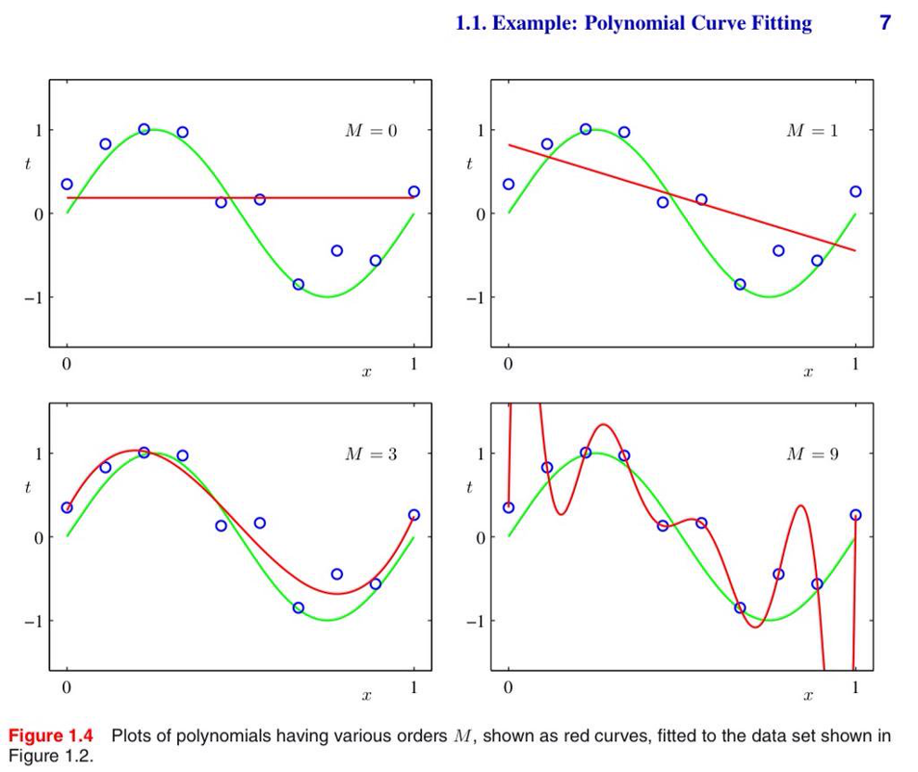
Traditional: ML - Curve fitting, pattern detection

Slide 13
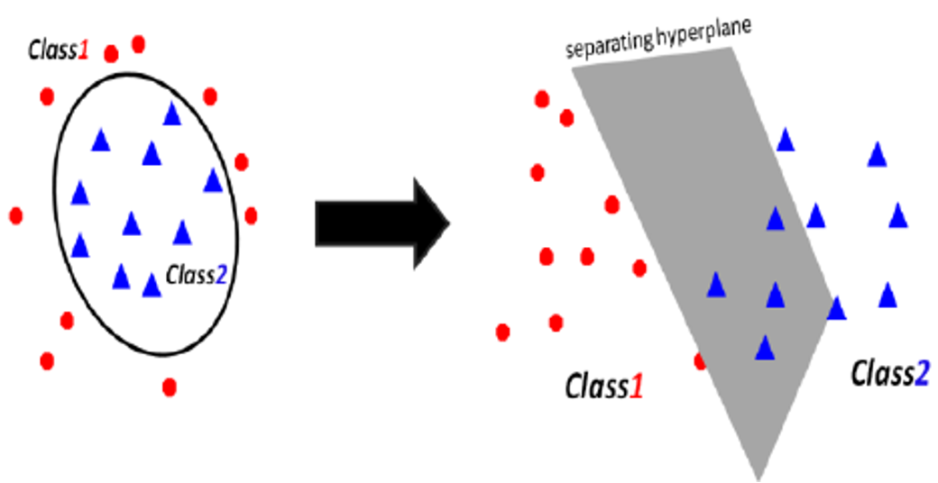
Traditional: ML - Supervised ML

Slide 14
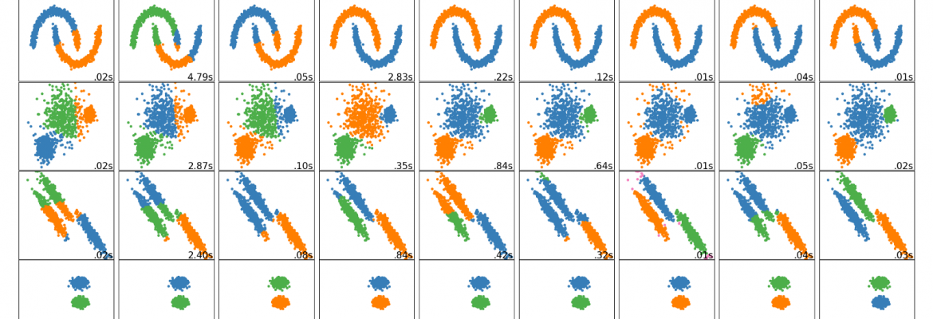
Traditional: ML - Clustering

Slide 15
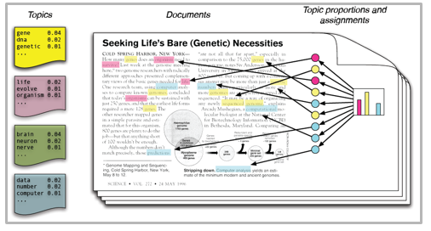
Traditional: ML - Topic modelling

Slide 16
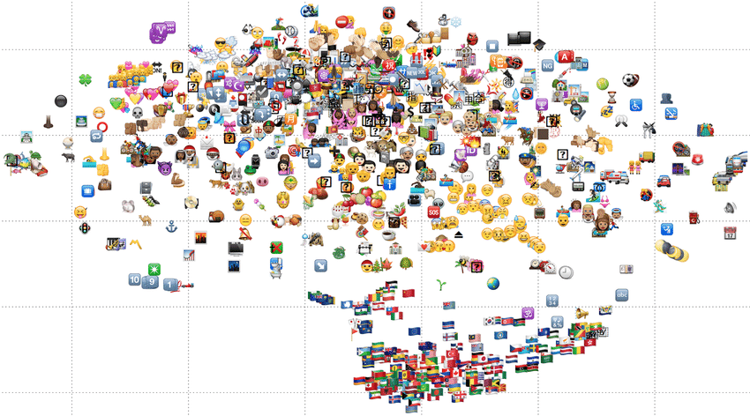
Traditional: ML - t-SNE

Slide 17
Breakthroughs - Deep learning
Deep learning offers a way to harness large amounts of computation and data with little engineering by hand
Overcome/decrease the limitations of relying on annotated data
Language modeling has become the ultimate aim of text processing studies. If you have a perfect language model, you can
answer questions,
detect entailment,
generate correct answers in a correct way
A language model provides a mapping of text to a vector space

Slide 18
Breakthroughs
Distributed Representations, learn static context
Word Embeddings
Character/ngram Embeddings
Pretrain on unlabeled data, learn dynamic context
pre-trained contextual architectures
Transfer Learning, e.g. from large MT parallel corpora
transformers
Multitask learning
CNN
Recurrent Neural Networks
LSTM/BiLSTM/GRU
Attention Mechanism
Reinforcement Learning for sequence generation
Memory Augmented Networks

Slide 19
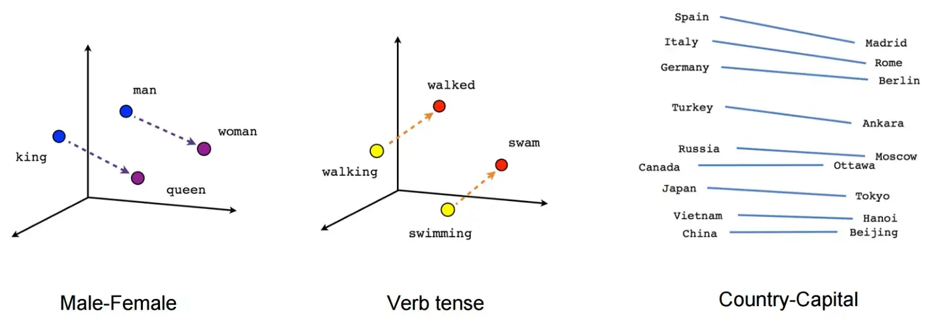
Breakthroughs - Word embeddings
vec(“China”) – vec(“Beijing”) = vec(“Russia”) - vec(“Moscow”)

Slide 20
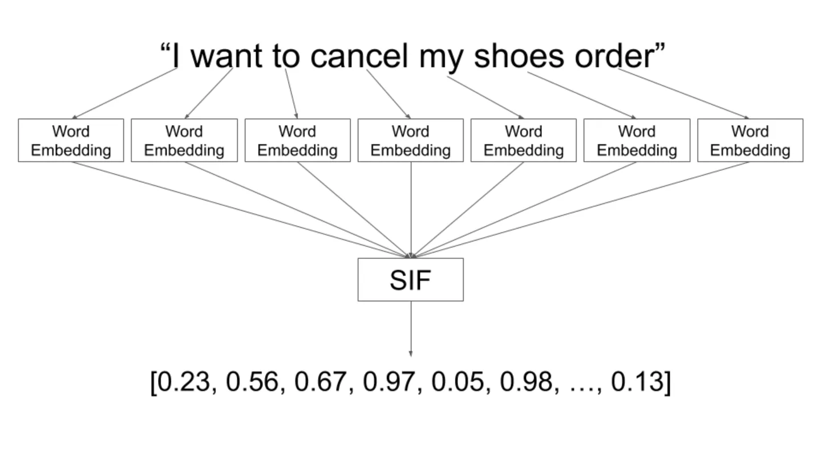
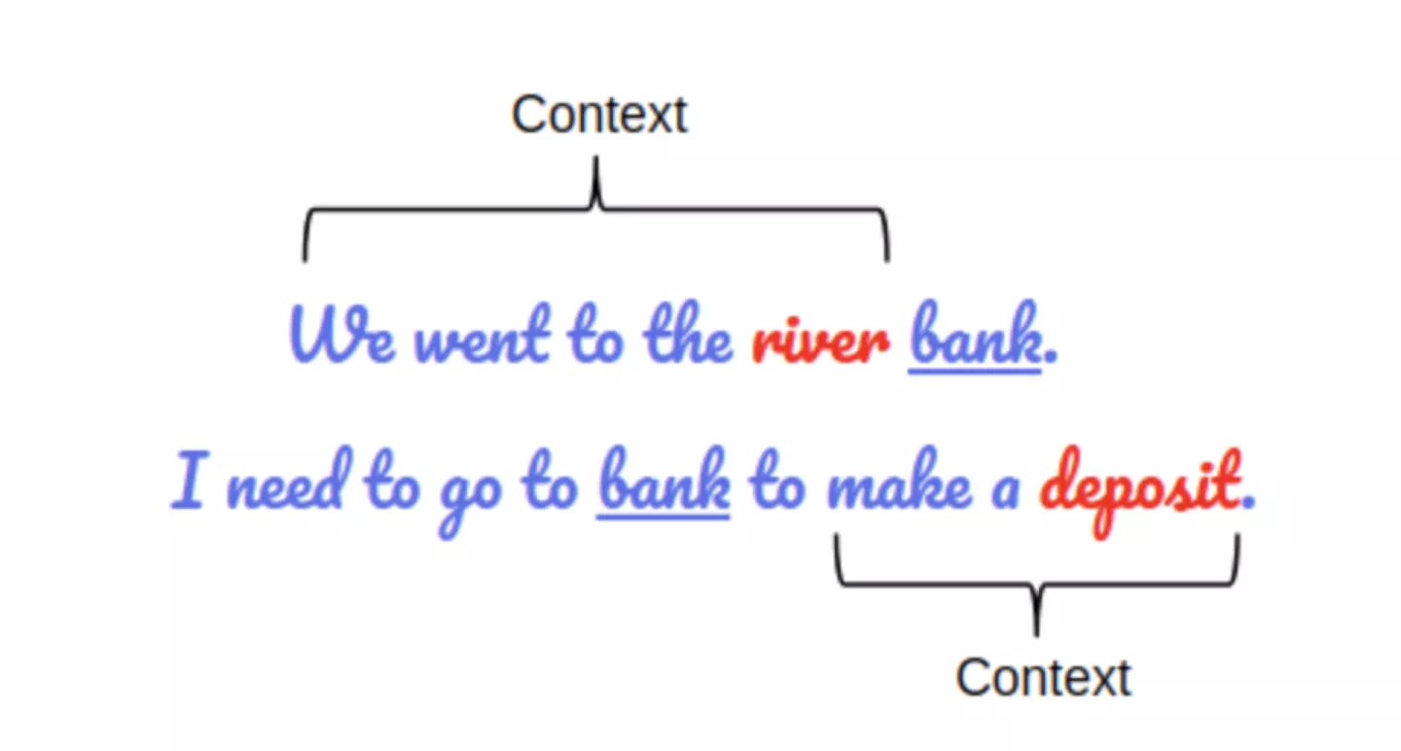
Breakthroughs - Sentence embeddings
Notes:
https://techblog.assignar.com/how-to-use-bert-sentence-embedding-for-clustering-text/

Slide 21
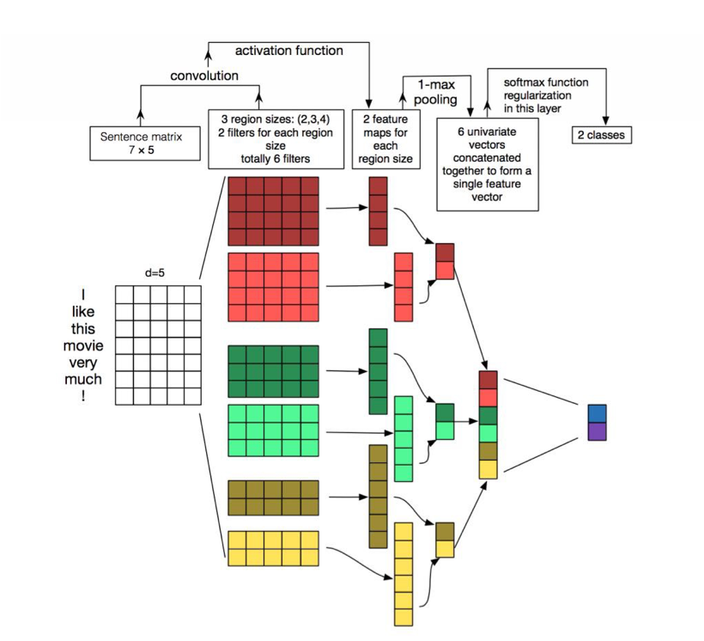
Breakthroughs - Architectures

Slide 22
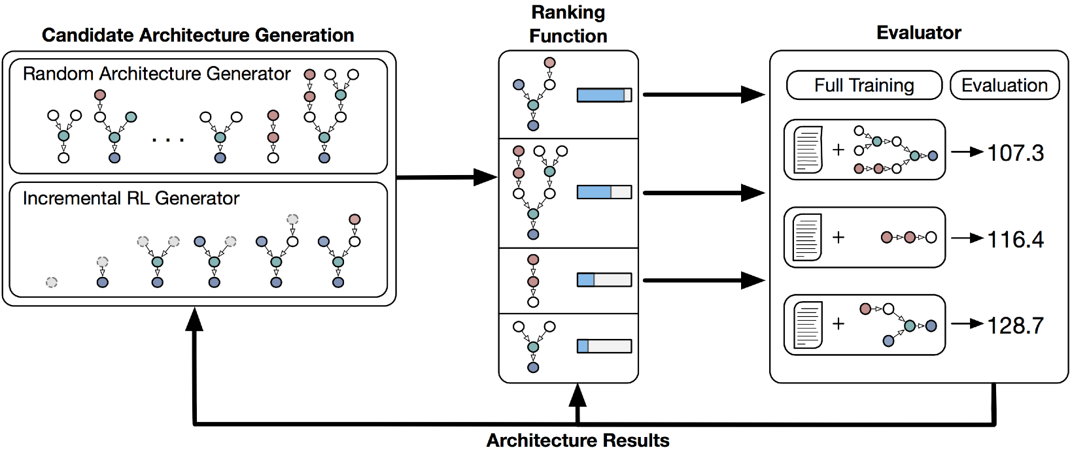
Breakthroughs - Architectures
Which architecture is the most effective?

Slide 23
Tools
NLTK, http://www.nltk.org
Scikit-learn, http://scikit-learn.org/
http://scikit-learn.org/stable/tutorial/text_analytics/working_with_text_data.html
LaMachine, https://github.com/proycon/LaMachine
fastText, https://fasttext.cc
Spacy: https://spacy.io

Slide 24
Conclusion
Level of automation has been drastically increasing
you need more computation and storage
data becomes more helpful with less input from you
You are losing control and may be mislead
Your task may not need deep learning
Some lexicon and rules may be much more effective than deep learning
We mostly use language models & architectures shared openly
Check https://huggingface.co/

Slide 25
Thanks for listening!
What questions do you have?
Reach me at: ali.hurriyetoglu@gmail.com

